Slide 1
Sentimental Data Analysis
Namish Narayan : 15UCS080
Yash Nag : 15UCS173

Slide 2
Outline
Discipline Description
Existing Systems
Literature Survey
Proposed Work
Results and Future Work
References

Slide 3
Discipline Description

Slide 4
Sentimental Data Analysis
Extracting and finding patterns through online posts
Used to gain an understanding of opinions and emotions
Helps understand user’s feelings
Classification of posts, tweets etc.
Essential for social media giants
Like Facebook, Twitter, Reddit etc.

Slide 5
Our Niché
Sentiment data classification
To Positive or Negative Sentiment
Tweets - Text based Data
Unstructured
Each line represents a tweet
Sentence Level Sentiment Extraction
Positive Sentiment
Negative Sentiment
Applications:
Tweet’s Sentiment
It’s appropriateness for certain audience
Gives overview about user and one’s activity online

Slide 6
Existing Systems

Slide 7
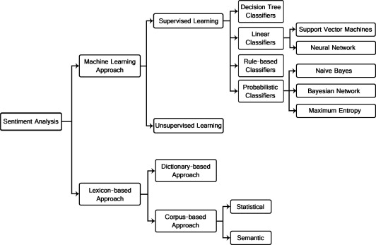
Existing Systems

Slide 8
Existing System
Machine Learning Approaches
Machine Learning algo’s for classification
Lower accuracy on small dataset
More features can be extracted
Easy to scale
Lexicon Based Approach
Syntactic Parsing and dictionary creation
Works on a word-by-word basis
Good for small dataset
More efficient
Hard to scale

Slide 9
Literature Review

Slide 10
Literature Review
Our main reference paper which we went through to get insides into the problem, is a paper by Duncan and Zhang, ‘Neural networks for sentiment analysis on Twitter’, listed as Reference [1]
They showed the importance of Sentiment Analysis and it’s wide application
Proposed a Neural Network solution to the problem, unlike traditional Lexicon based ones
Collected tweets using Twitter’s API
They discerned the tweets to find out the polarity of an opinion, such as positive, negative, or neutral.

Slide 11
Proposed Work

Slide 12
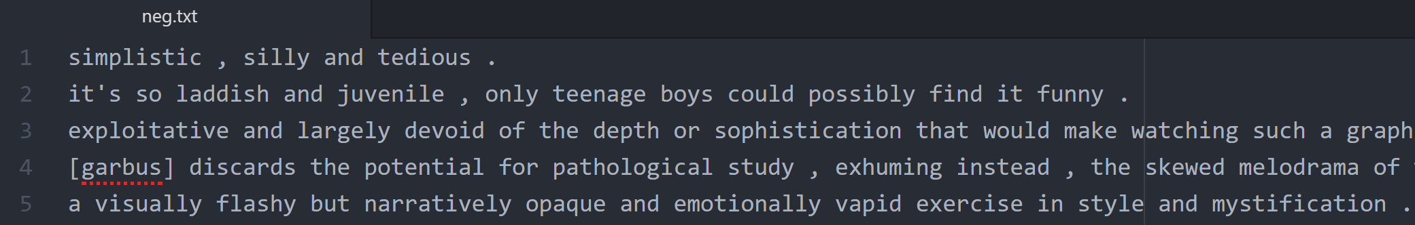
About the Data
2 Files for training and testing data each
Positive.txt
Negative.txt
Each file has 5331 lines
Each line is a tweet.
Class is defined by the name of the file.
Example:

Slide 13
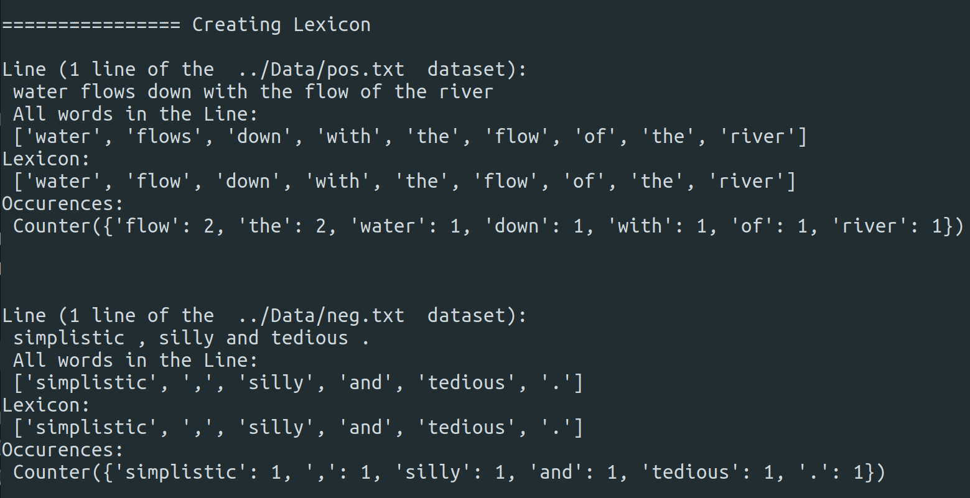
Preprocessing Data
Creating Lexicons
Extracting words from tweets
Removing multiple forms of a word
Dictionary of words that pass a certain criteria (or threshold), is called Lexicon
Lexicon for both Positive.txt and Negative.txt is merged to form 1 single lexicon for the entire database.
Useless characters or unimportant words are later received

Slide 14
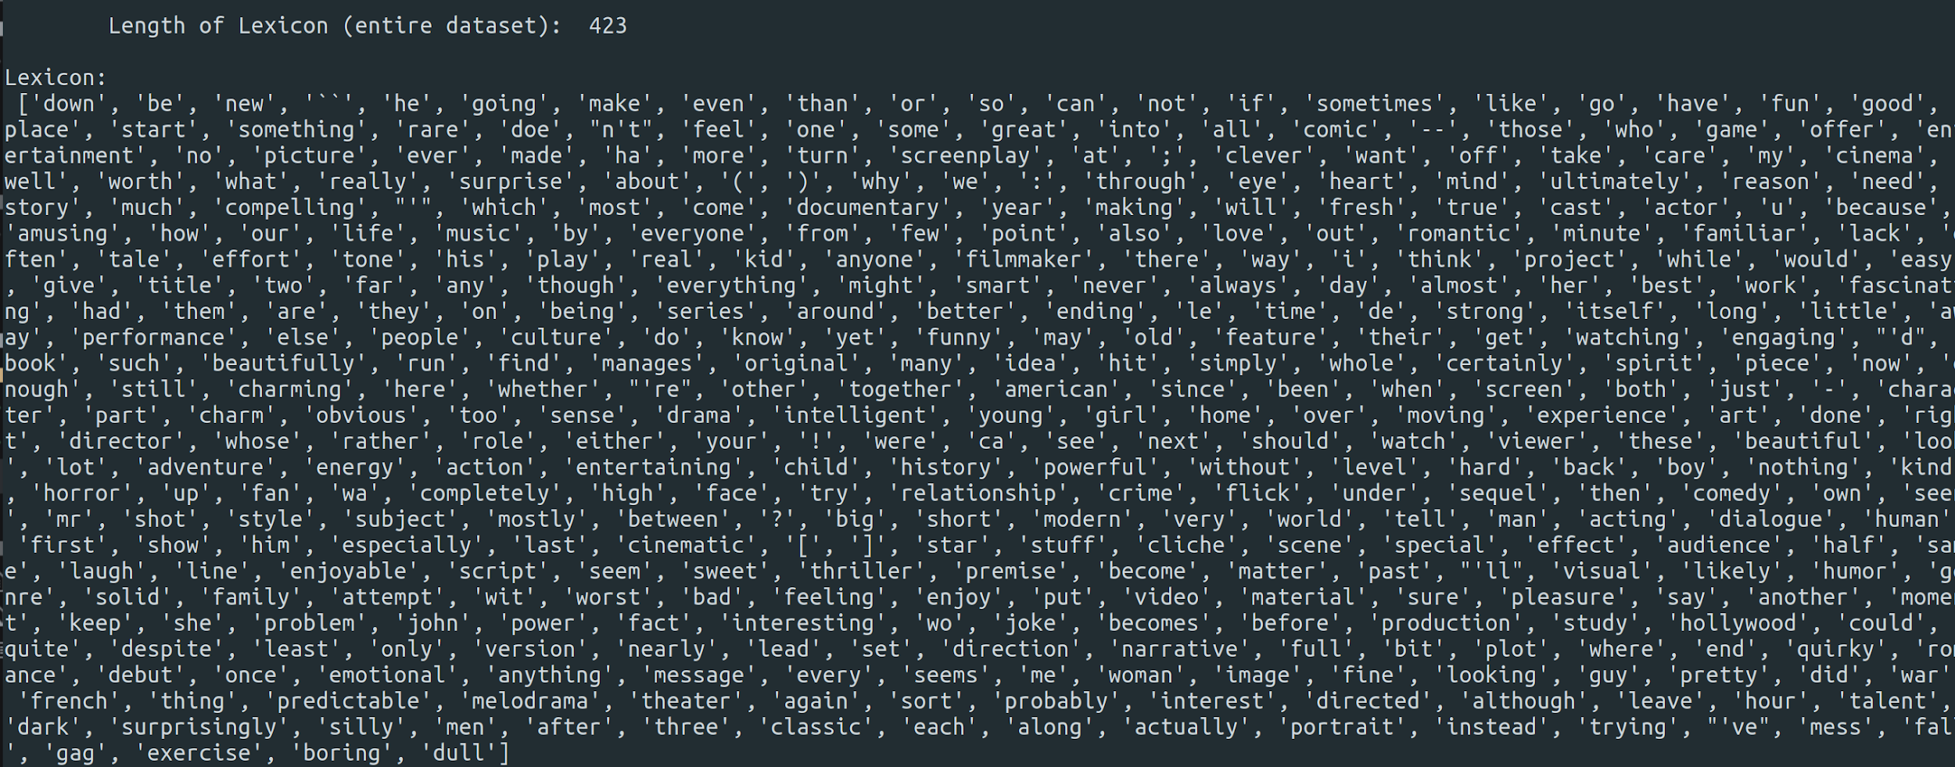
Preprocessing Data

Slide 15
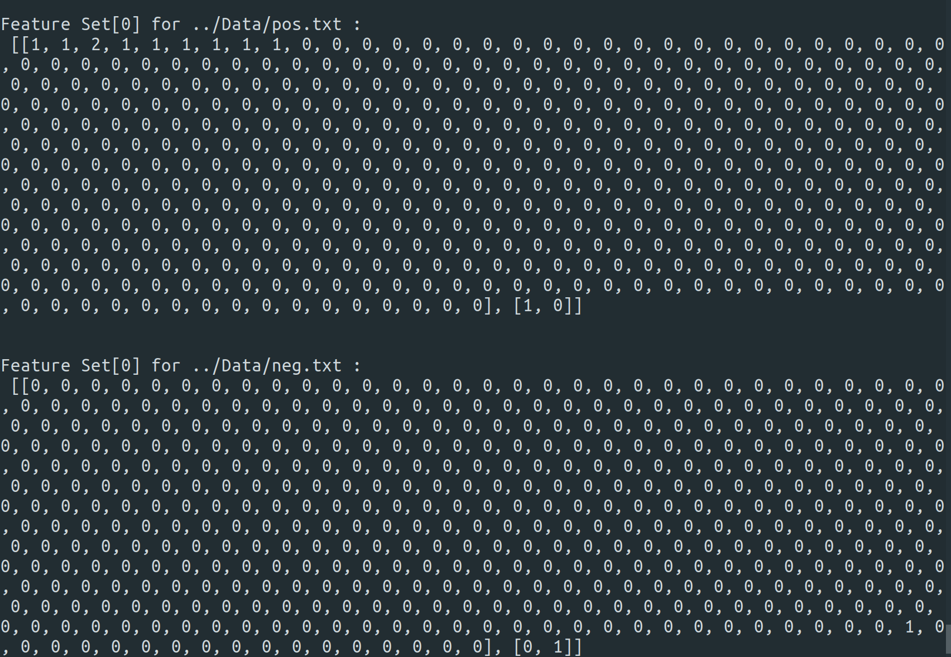
Preprocessing Data
Creating Vectors and Adding Labels
Each tweet is represented by a vector
A vector is an array, same length as a lexicon
Each element of the array corresponds to the Lexicon’s word at the same index
0 represents that the tweet does contain the corresponding word in Lexicon
1 (or more) represents the no. of occurrences of that word in that tweet
Labels are generated per tweet (or vector) with respect to the file they belong to
Vectors and Labels are combined in another array to form FeatureSet of a tweet.
Labels:
[1,0]: Positive
[0,1]: Negative

Slide 16
Preprocessing Data
Creating FeatureSets
FeatureSet of each tweet is created
FeatureSets is then shuffled amongst itself
Training and Testing Data is extracted from the FeatureSets and stored in a ADT, Pickle
The NN can now directly extract the data from the Pickle using the pickle library in Python

Slide 17
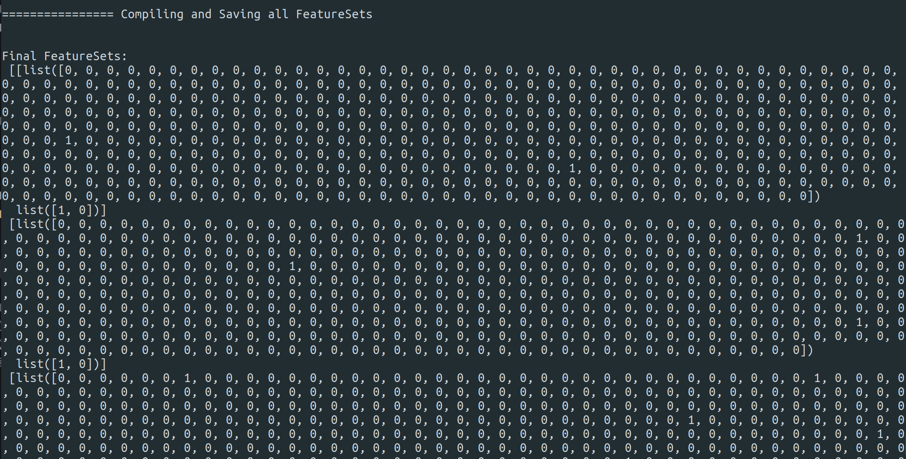
Preprocessing Data

Slide 18
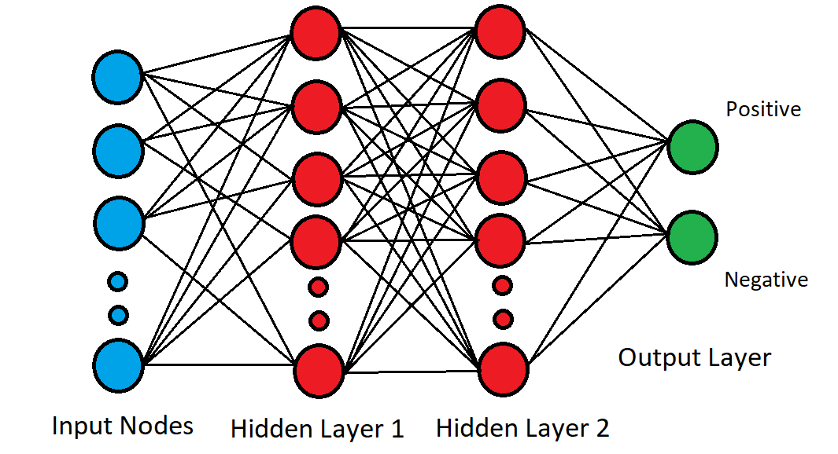
Neural Network
Neural Network Model
Built using TensorFlow, Data Manipulations using NumPy
Random Weights and Biases for initialization
1 Input Layer, 2 Hidden layers, 1 Output Layer
Input Layer has 423 Nodes (Length of Lexicon)
Output Layer has 2 Nodes (Positive and Negative Classes)
Hidden Layers have 350 and 100 nodes respectively

Slide 19
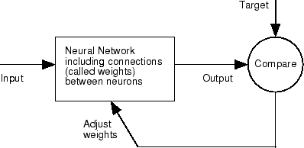
Training
Neural Network is trained using a ‘Training_Data’ and ‘Training_Labels’, subsets of FeatureSets
Training data are feeded into the Neural Network Input Layer
Feed Forward
Weights, Bias are initialized as random
Each featureset is inputted into Input Layer
Input Layer → Hidden Layers → Output Layer
Loss is calculated using output label, against defined label
Back Propagation
Output Layer → Hidden Layers → Input Layer
Weights and Biases of all hidden layers are adjusted according to the loss

Slide 20
Testing
Process is repeated for each training data sample
This process basically trains the Neural Network to interpret the input data (FeatureSet), apply weights and biases to it, then calculate the predicted Label (Sentiment) that’s the most appropriate
Both classes, Positive [1,0] or Negative [0,1] are defined by which of the values of the output node is greater
ie. if the output node’s value is [3.5019, 2.105], the Program interprets it as [1,0] which is a positive sentiment

Slide 21
Testing and Results
Neural Network is trained using a ‘Testing_Data’ and ‘Testing_Labels’, subsets of FeatureSets
Testing Data is feeded into the Neural Network and values (or calculated labels) are compared to that of Testing Labels (or actual labels).
Accuracy is measured by dividing the number of correct predictions by total number of samples in Testing Data.
NN can also be feeded any random sentence and, by the similar process, can obtain the predicted label or sentiment.

Slide 22
Results | Future Work

Slide 23
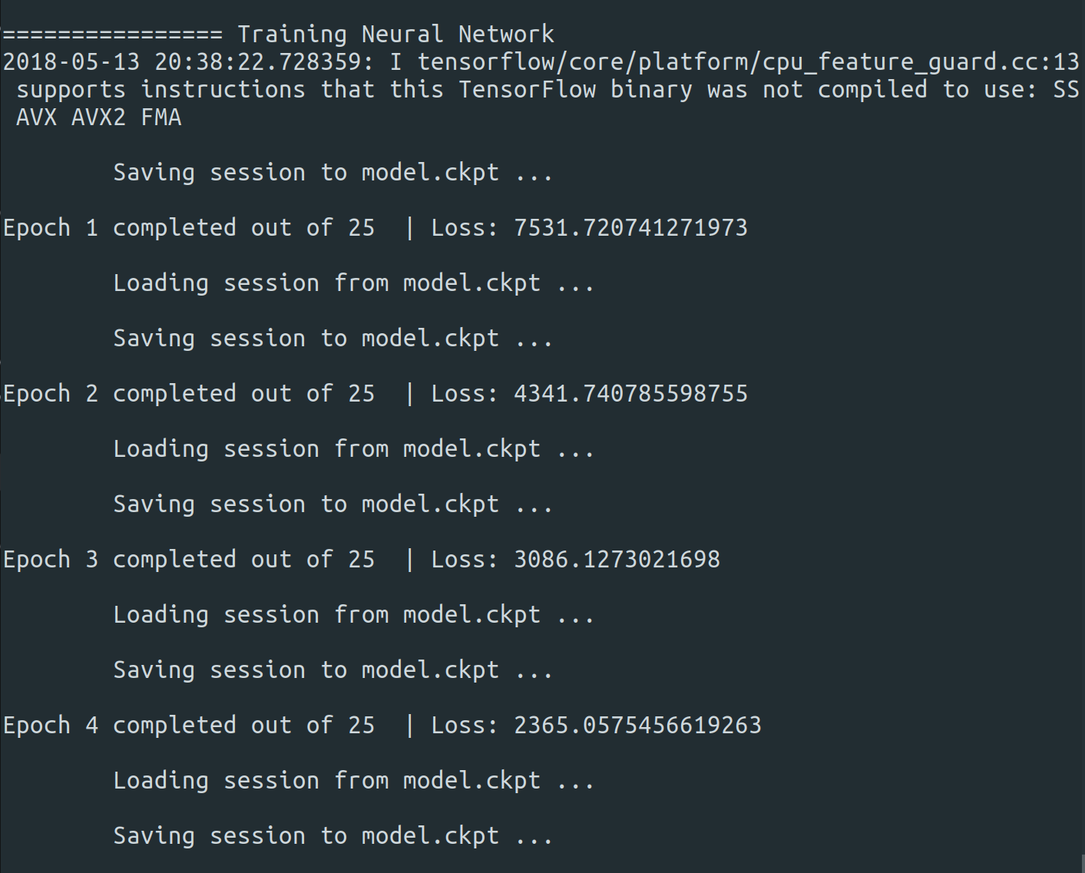
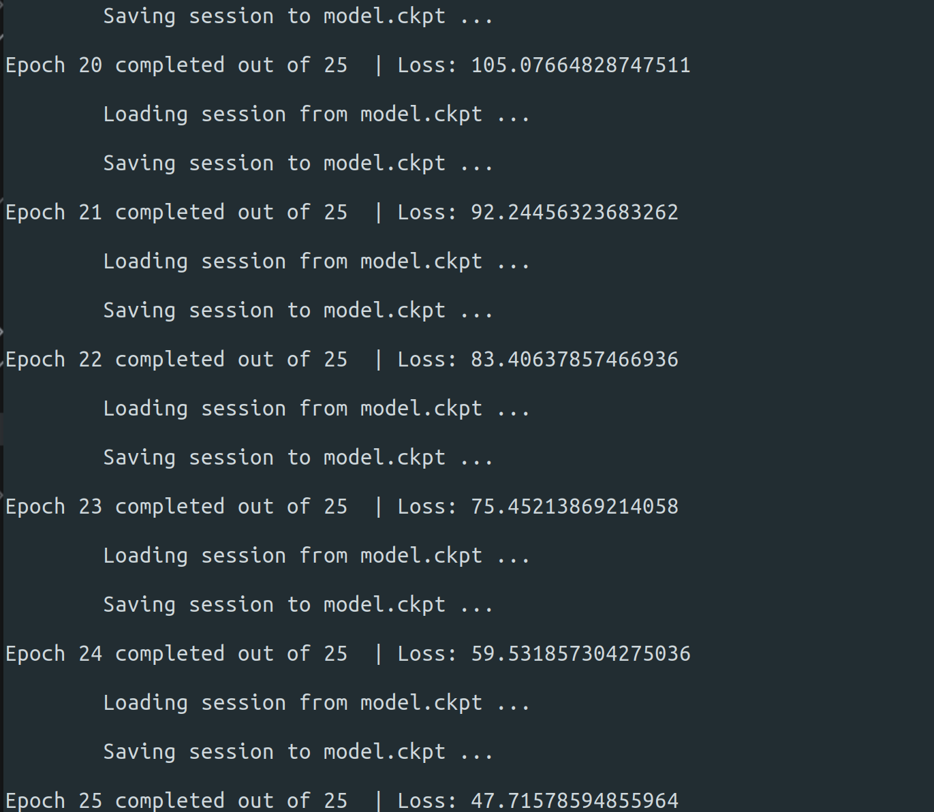
Results (Cost Reduction and Accuracy)

Slide 24
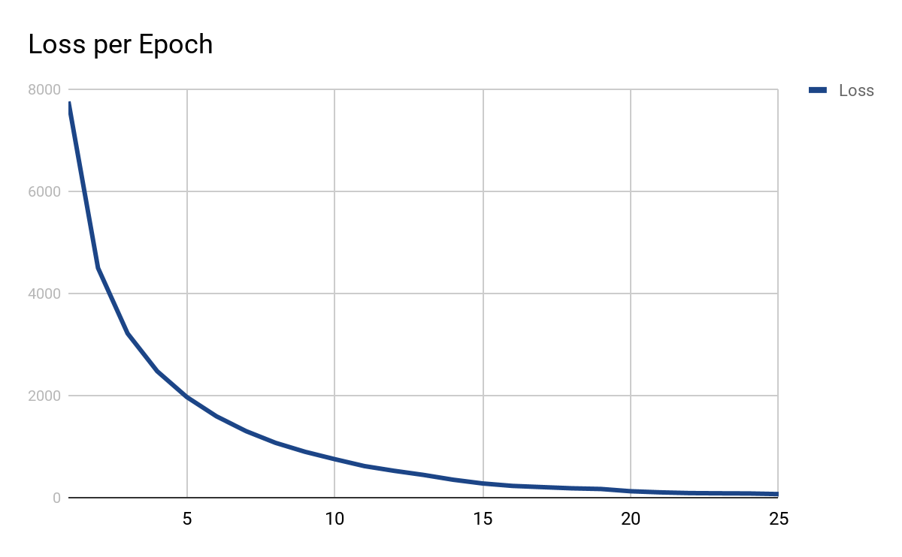
Results (Cost Reduction and Accuracy)

Slide 25
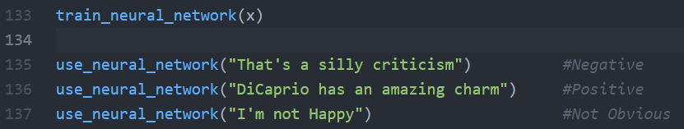
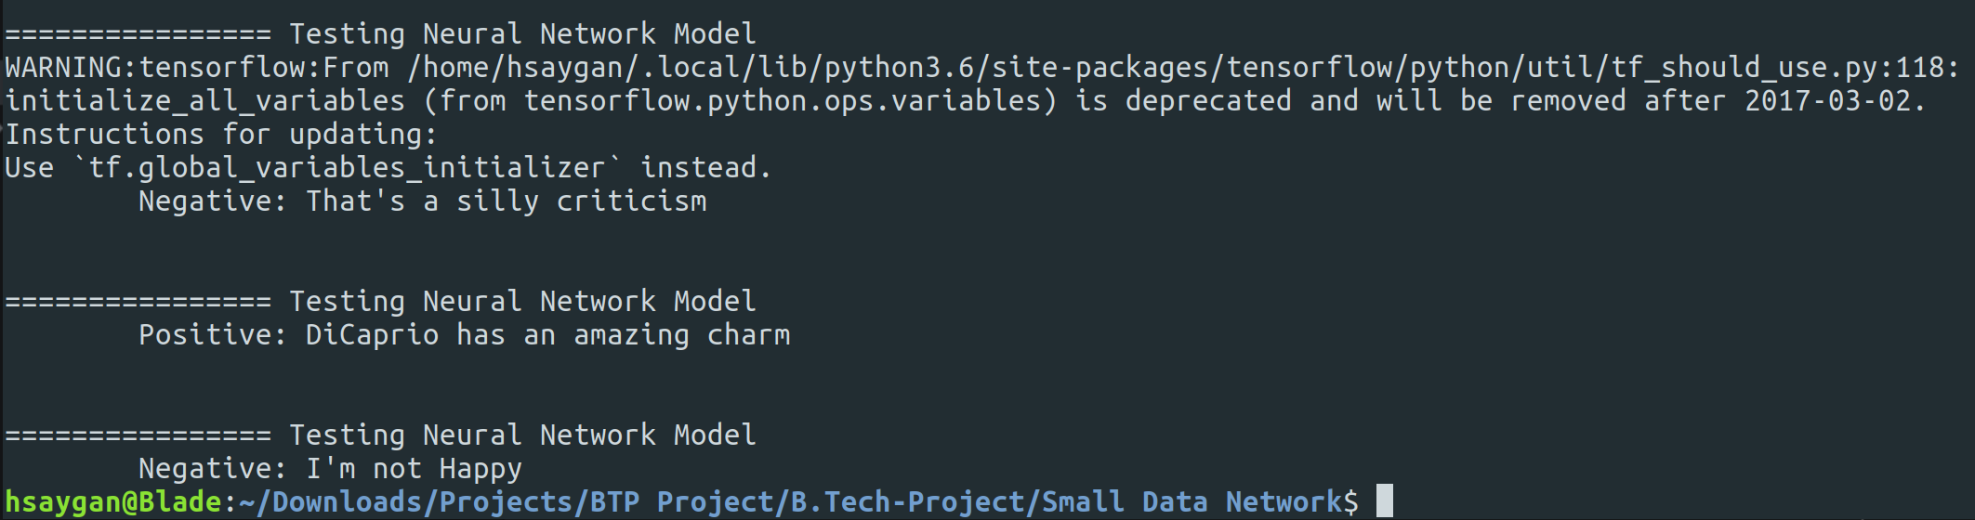
Results (Random Sentence)
Input:
Result:

Slide 26
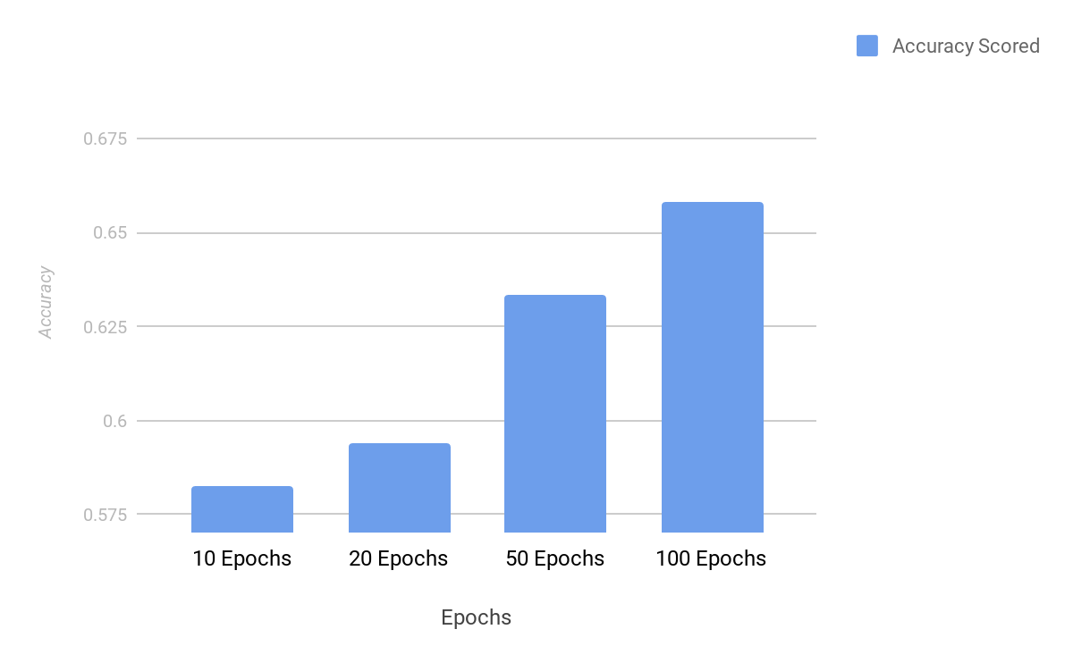
Results (Variations of NN Models)
Variation in Epochs
Inference:
Increase in the number of Epochs, trains the neural network more to that particular set of training data,
Hence the accuracy improves, but minutely over large difference over epochs.

Slide 27
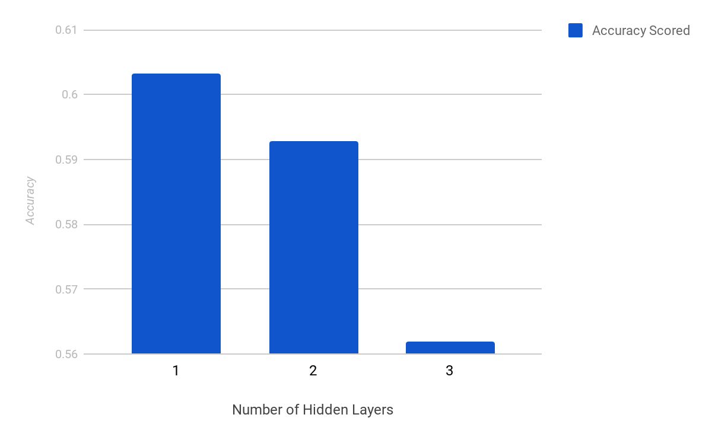
Results (Variations of NN Models)
Variation in Number of Hidden Layers
Inference:
Since the complexity of calculating sentiments is not that complex, and more hidden layers need more training to perform admirably,
Increasing the number of hidden layers decrease the accuracy.

Slide 28
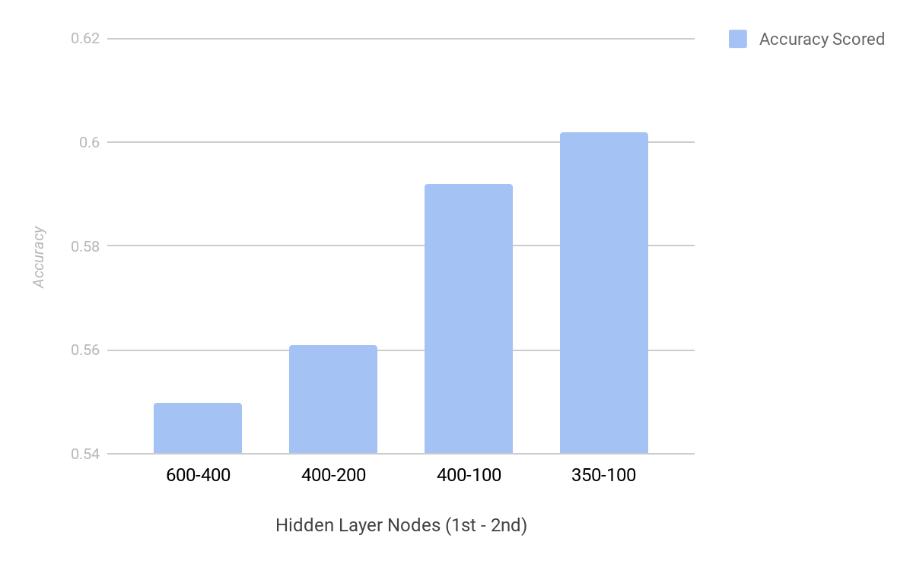
Results (Variations of NN Models)
Variation in Number of Nodes in Hidden Layers
Inference:
Similar to inserting more number of hidden layers, hidden layer’s nodes also increase the complexity of the neural network.
Here, we chose 350-100 as our standard as it scored the best in our testings.

Slide 29
Future Work
Increase the amount of data to more than a few hundred thousand lines.
Better, and wider feature extraction. Not limiting to positive and negative sentiments only.
More preprocessing updates to threshold useless words being feeded into the lexicon.
More classes to classify to, which may include, “Neural, Angry, Distressed” etc. in the output for more insights into the data.
Construct Recurrent Neural Networks to improve classification.

Slide 30
References

Slide 31
References
[1] B. Duncan and Y. Zhang, "Neural networks for sentiment analysis on Twitter," 2015 IEEE 14th International Conference on Cognitive Informatics & Cognitive Computing (ICCI*CC), Beijing, 2015.
[2] Q. Cao, W. Duan, and Q. Gan. Exploring determinants of voting for the helpfulness of online user reviews: A text mining approach. Decision Support Systems, 50(2):511–521, 2011.
[3] C.C.ChenandY.-D.Tseng. Quality evaluation of product reviews using an information quality framework. Decision Support Systems, 50(4):755–768, 2011.

Slide 32
References
[4] S. Deerwester, S. T. Dumais, G. W. Furnas, T. K. Landauer, and R. Harshman. Indexing by latent semantic analysis. Journal of the American society for information science, 41(6):391, 1990.
[5] A. Fahrni and M. Klenner. Old wine or warm beer: Target-speciﬁc sentiment analysis of adjectives. In Proc. of the Symposium on Affective Language in Human and Machine, AISB, pages 60–63, 2008.
[6] M. Hu and B. Liu. Mining and summarizing customer reviews. In Proceedings of the tenth ACM SIGKDD international conference on Knowledge discovery and data mining, pages 168–177. ACM, 2004.

Slide 33
References
[7] N. Hu, I. Bose, N. S. Koh, and L. Liu. Manipulation of online reviews: An analysis of ratings, readability, and sentiments. Decision Support Systems, 52(3):674–684, 2012.
[8] H. Kang, S. J. Yoo, and D. Han. Senti-lexicon and improved naiiıve bayes algorithms for sentiment analysis of restaurant reviews. Expert Systems with Applications, 39(5):6000–6010, 2012.
[9] S.-M. Kim and E. Hovy. Determining the sentiment of opinions. In Proceedings of the 20th international conference on Computational Linguistics, page 1367. Association for Computational Linguistics, 2004.

